Slide 1
packaged water plantbottle® activation
August 2013

Slide 2
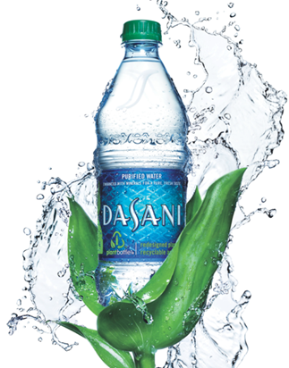
PlantBottle™ Toolkit
PlantBottle is a vital initiative to advance our KO Water Brand ambition.
It is the first ever recyclable PET plastic bottle made partially from plants. In launched markets, PlantBottle has driven sales, brand preference, and customer engagement. All while making a real social impact by reducing environmental footprint and empowering people to make better sustainable choices.
This document provides essential information & guidance to successfully launch Plantbottle if your market.

Slide 3

Toolkit Contents
overview
Strategic Overview ........................................ 4
Business Opportunity …………………………… 11
Technical Guidance ……………………………… 16
Activation …………………………………………… 22
OWNED
EARNED
SHARED
PAID
Accessing Materials, Rights & Usage ...……. 30
Contact ……………………………………………. 33

Slide 4
1. Strategic Overview

Slide 5

Enabling prosperity through action
strategic overview
“Water is an essential component of growth, social and economic development, poverty reduction and equity…”.
(3rd UN Water report – 2009)
We believe that water is a fundamental enabler of individual & societal progress. But it’s what we do, and the genuine, meaningful actions we take around water that can make a difference for society.
SOCIETY PROSPERS
WATER
SOURCE OF LIFE
GROWTH ENABLER

Slide 6
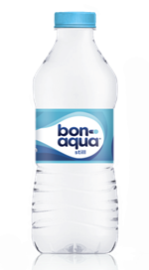
Creating Shared Value with Our Brands
strategic overview
‘SHARED VALUE’
Enhancing our competiveness while simultaneously advancing the economic and social conditions of the communities we operate in
By enabling personal & social growth our Water Brand help drive a virtuous cycle -- where our Brand actions create real social impact, and this in turn enhances our Brand differentiation & competitiveness.
We call this creating ‘Shared Value’. And this is the strategy for KO Water.
SOCIETY
prospers
KO WATER prospers

Slide 7
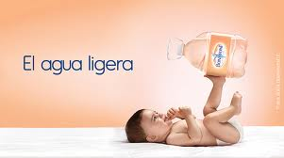
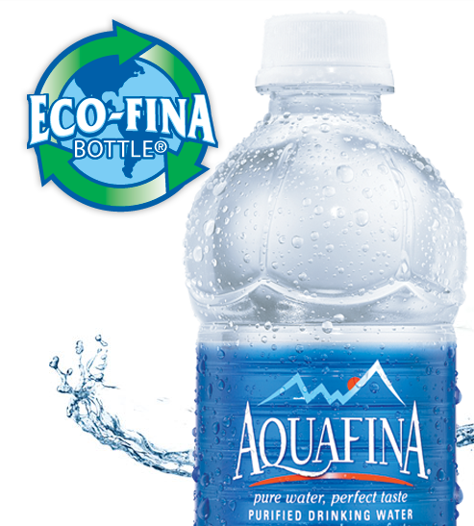
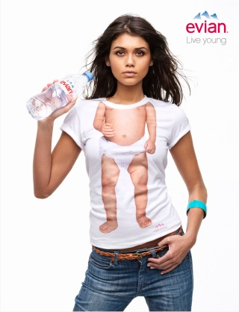
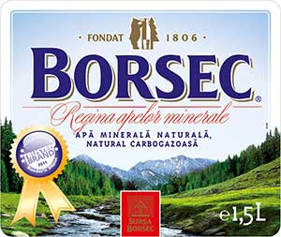

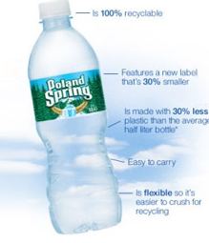
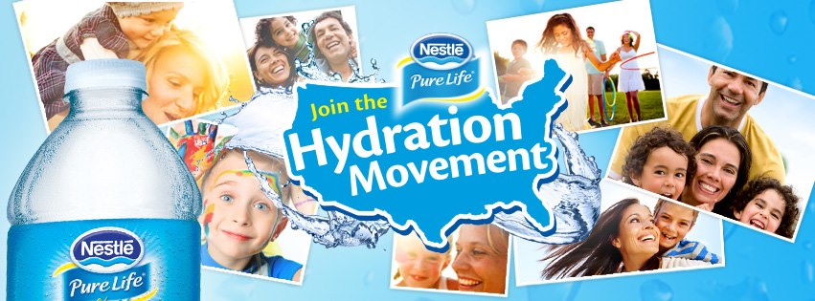
Breakthrough differentiation is hard to find
strategic overview
Advancing the Shared Value strategy only happens when our Brand creates truly different consumer experiences.
Presently, the water category is a sea of sameness. Most brands focus on cost-of-entry attributes of hydration, naturalness, or purity. Sustainability programs are generally easily replicated, focusing on plastic reduction.

Slide 8
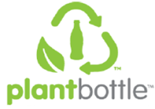
PlantBottle™ is breakthrough innovation
strategic overview
PlantBottle is real differentiation. It is the first ever recyclable PET plastic beverage bottle made partially from plants.
PlantBottle packaging looks, functions and recycles just like traditional PET plastic, but does so with a lighter footprint on the planet and its scarce resources.
TCCC has committed that all PET will be first generation PlantBottle by 2020 because it:
Is a proven brand building asset
Drives Corporate leadership
Hedges against oil pricing
Notes:
Why PlantBottle?
Corporate Leadership Opportunity
Packaging is TCCC’s largest CO2 source
PlantBottle reduces environmental impact
PlantBottle will change entire plastic industry
Hedge Against Oil Pricing
PET is ~60% of TCCC packaging and growing, critical to 2020 goal
Oil pricing is highly volatile and trending up
Brand Building
When promoted correctly, PlantBottle is an ownable point of differentiation driving trail & repeat
Natural cues of packaging reinforce positive qualities of product
PlantBottle fights negative category perceptions among customers and consumers
PlantBottle is a massive system-wide investment.
All PET will be first generation PlantBottle by 2020

Slide 9
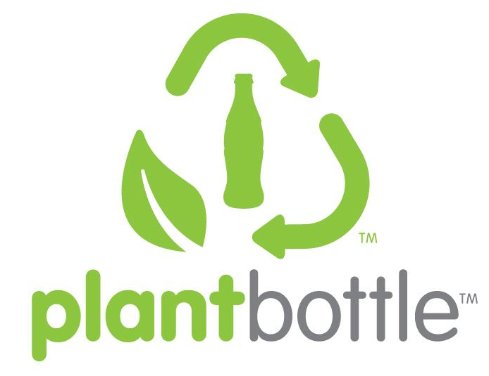
PlantBottle™ is a powerful initiative to create Shared Value
strategic overview
STRATEGY
Lead category transformation through
Shared Value creation
On our roadmap to Water leadership, PlantBottle is a pivotal proof point to building Shared Value credentials, and creating meaningful differentiation in the category.
Drive efficiency & reduce waste
FOUNDATION
Build Shared Value credentials
EVOLUTION
Redefine the category based on Shared Value
TRANSFORMATION
Global VIS
Water Your Potential IMC
Global Liquid Idea 2.0
BVA: Water Human Potential
Ecoflex

Slide 10
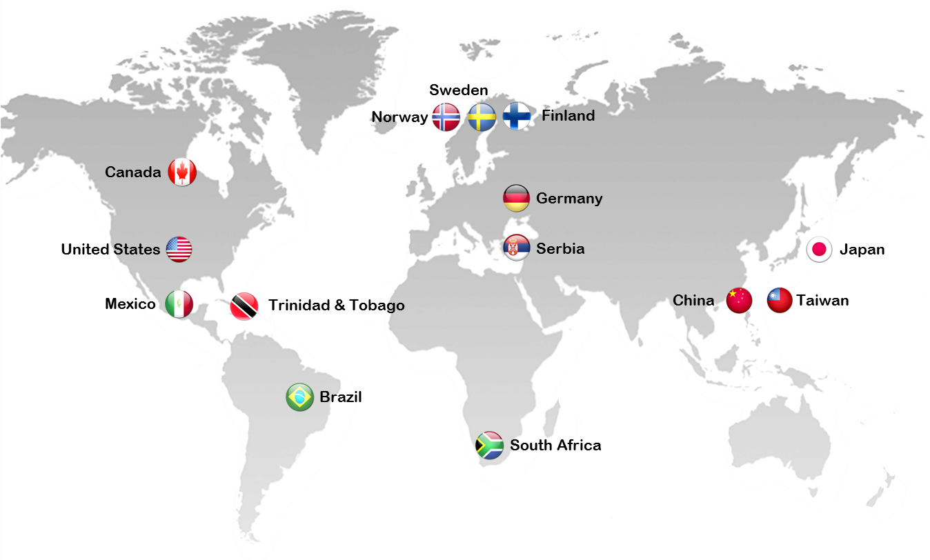
Accelerating PlantBottle expansion to drive leadership
strategic overview
Since 2009 PlantBottle has been launched across 12 markets in water, helping advance our brands with meaningful differentiation versus competition.
Water Brands:
2009 – US & Canada Dasani
2010 – Japan iLOHAS
2010 – Sweden & Norway Bonaqua
2011 – South Africa Valpre
2011 – Germany ViO
2012 – Serbia Rosa
2012 – Mexico Ciel
2012 – Brazil Crystal
2012 – Hong Kong & Taiwan Bonaqua
2012 – US & Canada smartwater
2013 – Trinidad & Tobago Dasani
2013 – Finland Bonaqua

Slide 11
2. Plantbottle™ Proven Success Stories

Slide 12

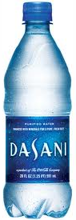
USA: PlantBottle revives Dasani
proven success stories
2009
2012
DASANI (US)
Pre-PlantBottle Background
In 2009, consumers were leaving bottled water category due to negative perceptions of packaging’s impact on the environment
DASANI was losing volume share due to lack of differentiation in marketplace & competitive pricing
DASANI experienced delisting in major retail chains
Strategy
Reposition brand by leading in packaging sustainability
Point of Differentiation: PlantBottle as unique, ownable proof point to connect with consumers desire for a smarter bottle
Showcase brand leadership: Natural packaging cues to reinforce positive product qualities & strengthen premium positioning
Increase authorizations: PlantBottle as vehicle to meet customer demand for reduced carbon impact

Slide 13
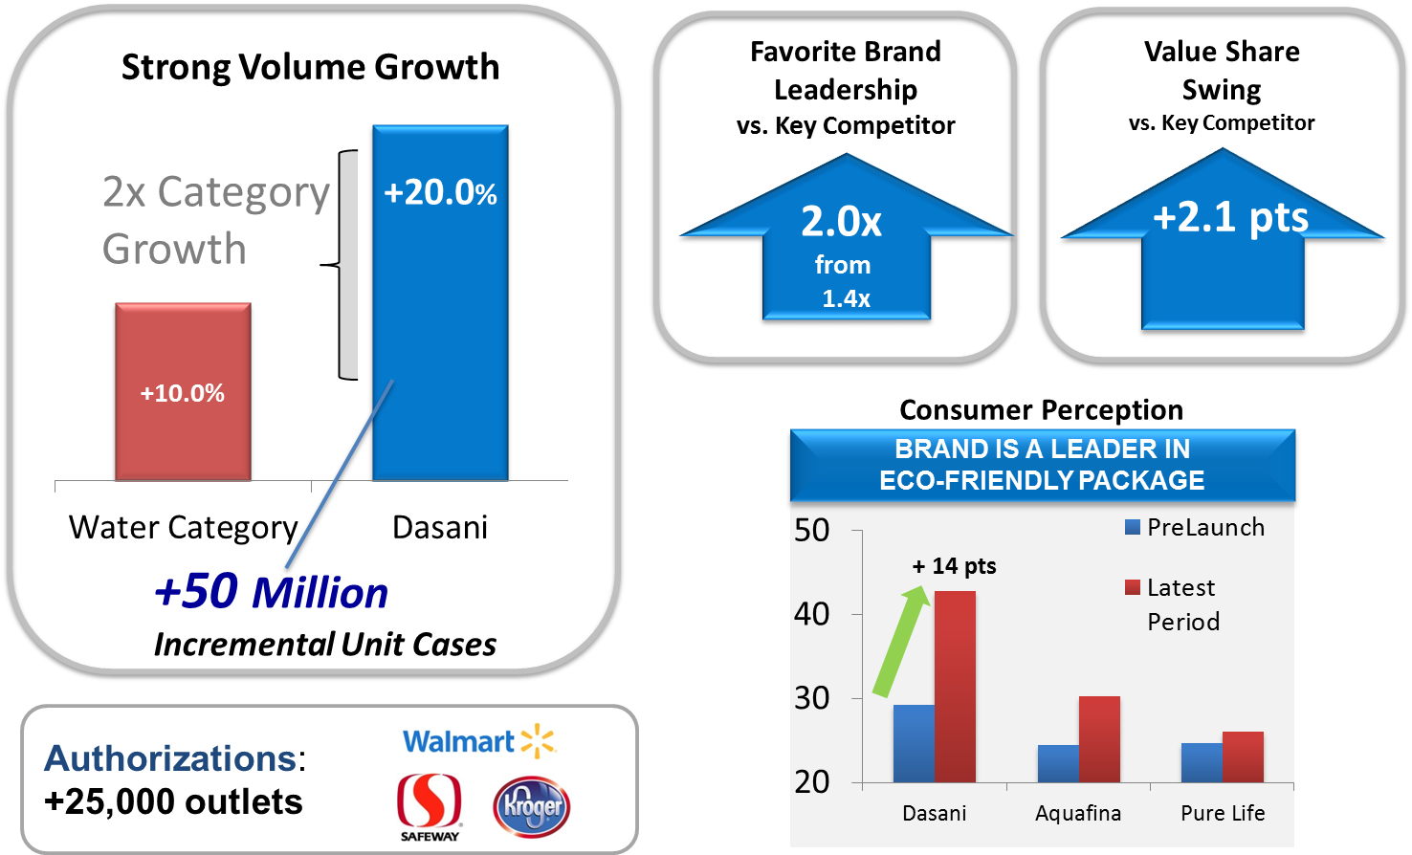
USA: PB drives volume, value, brand health & authorization lift
proven success stories
Results
Dasani seen as ‘leader is eco-friendly packaging’
Consumers recognize Dasani as their ‘favorite brand’ more since the PlantBottle campaign began, extending its lead over the competition
Dasani saw its daily drinkers increase from 10MM to 12MM (+20%)
Dasani is winning both value and volume share
Value share has increased 2.1pts vs. competition
Volume jumped 50MM incremental unit cases, outpacing category growth 2 to 1
Dasani was reauthorized in over 25,000 outlets between 2010 and 2012, including Walmart & Safeway.

Slide 14
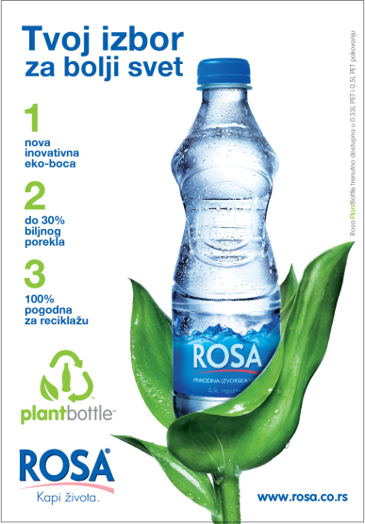
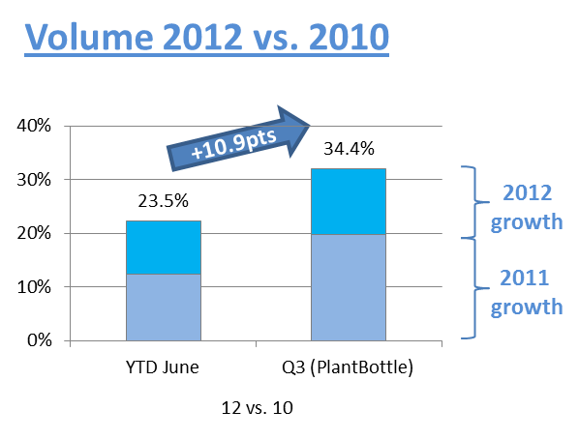
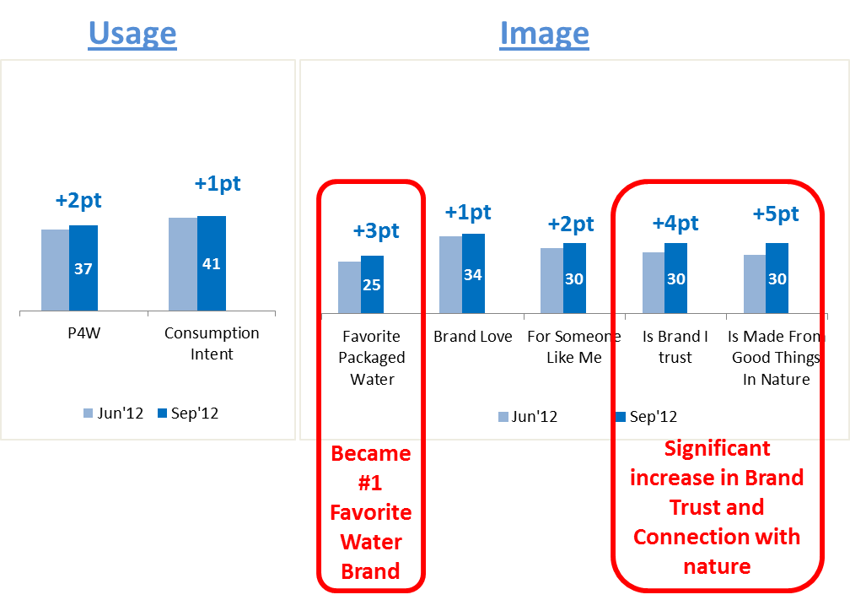
Serbia: PlantBottle advancing Rosa
proven success stories
Rosa (Serbia)
Serbia introduced PlantBottle to address shrinking category leadership and reboot brand that was perceived as “old and undifferentiated”
Results
Volume growth, back on double digit trend
Rosa is clear #1 Still Water - YTD Sep12 27.1% (+2.6pts vs. LY, +5.8pts vs. 2LY)
Rosa increases its gap with Aqua Viva, on all parameters
Rosa became Favorite Packaged Water Brand
Rosa is within Top 5 AFB brands in Brand Trust
Rosa is #1 player in local AFB digital arena with FB page of 165.000 fans
Rosa now is pure, healthy, persistent, composed, traditional, trustful, family oriented, yet at the same time up to dated, modern, dynamic and urban (Censydiam Jun12)

Slide 15
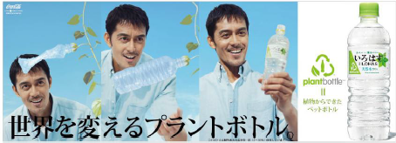
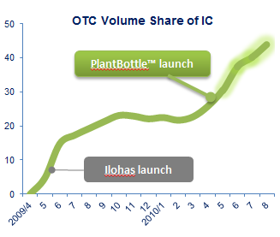
Japan: PlantBottle fortifies the ILOHAS proposition
proven success stories
ILOHAS (Japan)
Japan introduced PlantBottle in 2010 soon after its successful ILOHAS launch. PlantBottle further reinforced the differentiated sustainability positioning of the ILOHAS brand.
Results
Helped vault ILOHAS volume share +4.7pts
Strengthened ILOHAS differentiated positioning around sustainability
Further built share and sustainability leadership in all categories

Slide 16
3. Technical Guidance

Slide 17
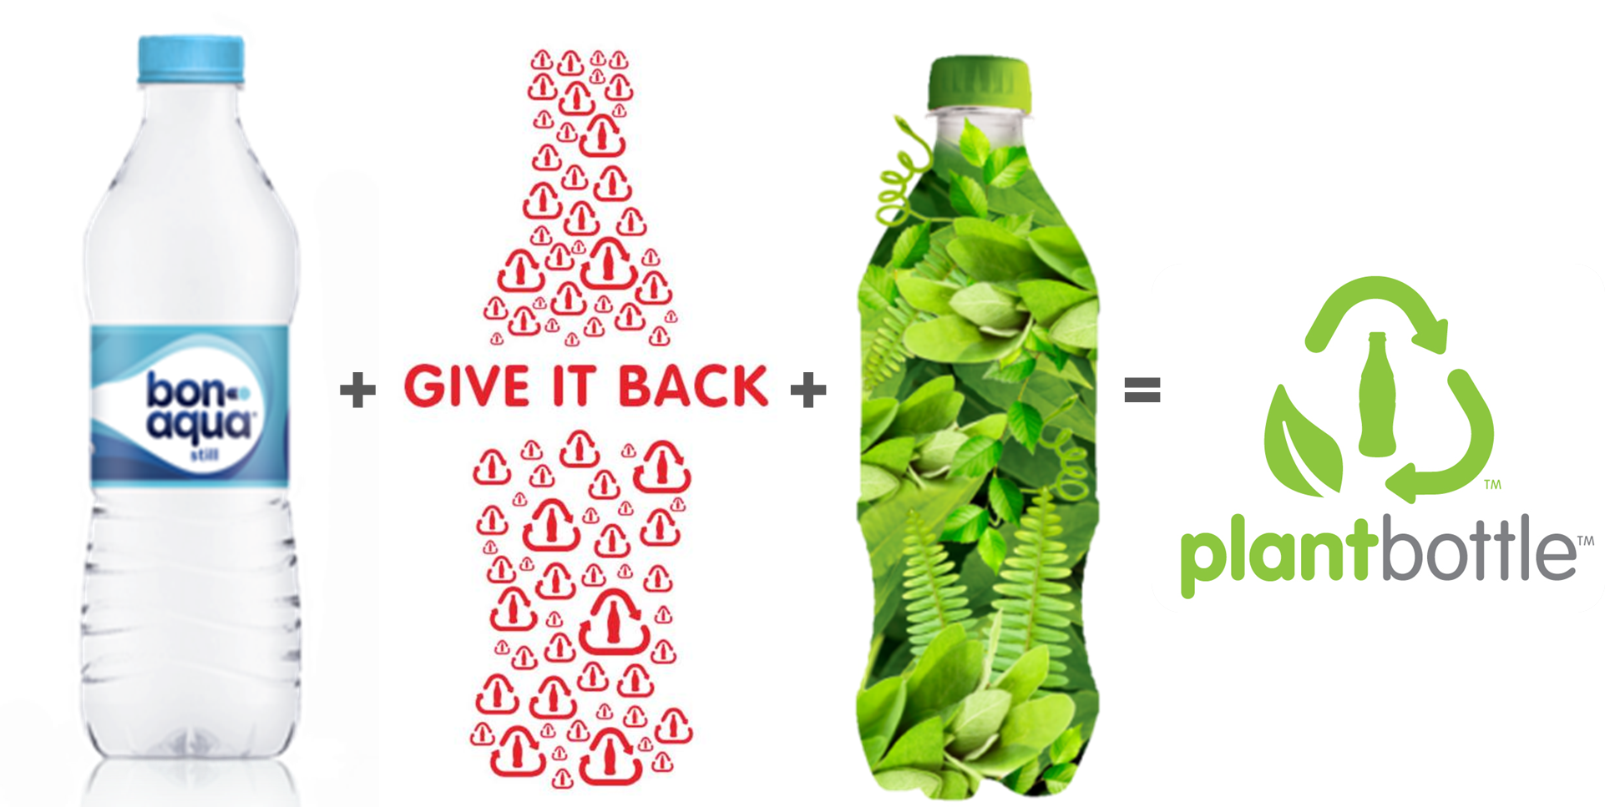
What is PlantBottle?
technical guidance
PlantBottle is PET as you know it.
The innovative breakthrough is that it is partly made from plants as opposed to oil.
+ Fully recyclable
+ Cost competitive to oil-based PET
+ Commercially viable today
PlantBottle is the only bottle that is Functional + Recyclable + Renewable
Functional
Recyclable
Renewable

Slide 18
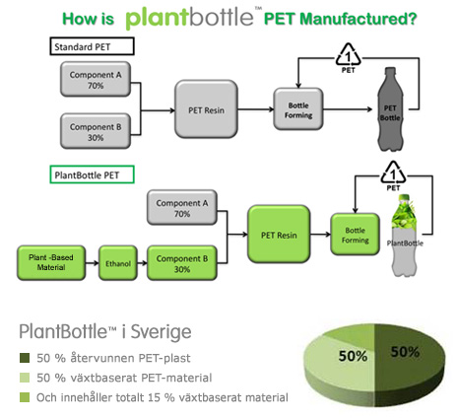

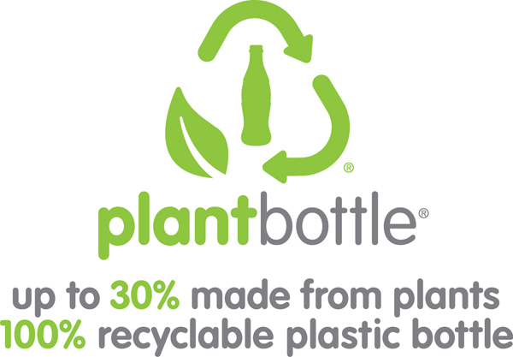
Resin Supply
technical guidance
PlantBottle resin is PET resin.
The only difference is that the MEG is sourced from plants as opposed to oil. MEG is 30% of PET by weight.
The only implications for production are:
Small additional capital costs making sure PB resin is in different silo than traditional resin.
Line test only necessary if PB resin supplier is new supplier

Slide 19
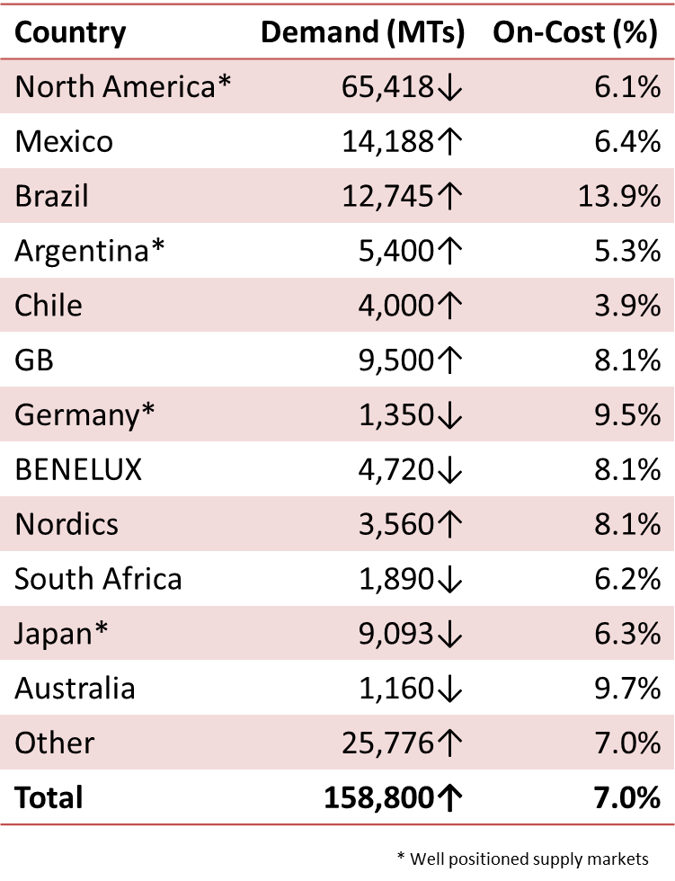
Resin Cost
technical guidance
Global procurement targets for PlantBottle™ have been met or beat every year since introduction:
2010 Target: 15-20% (14.5% Achieved)
2011 Target: 10-15% (6.5% Achieved)
2012 Target: 10-15% (14% Achieved)
Market conditions look very favorable for PlantBottle program over next couple years with traditional MEG prices increasing
Global average on-cost for PlantBottle expected to drop to 7% in 2013.
Water packaging requires less resin than other categories. Oncost for PlantBottle is below TCCC average of $0.03 to $0.04 per unit case.

Slide 20
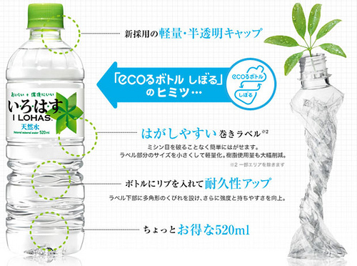
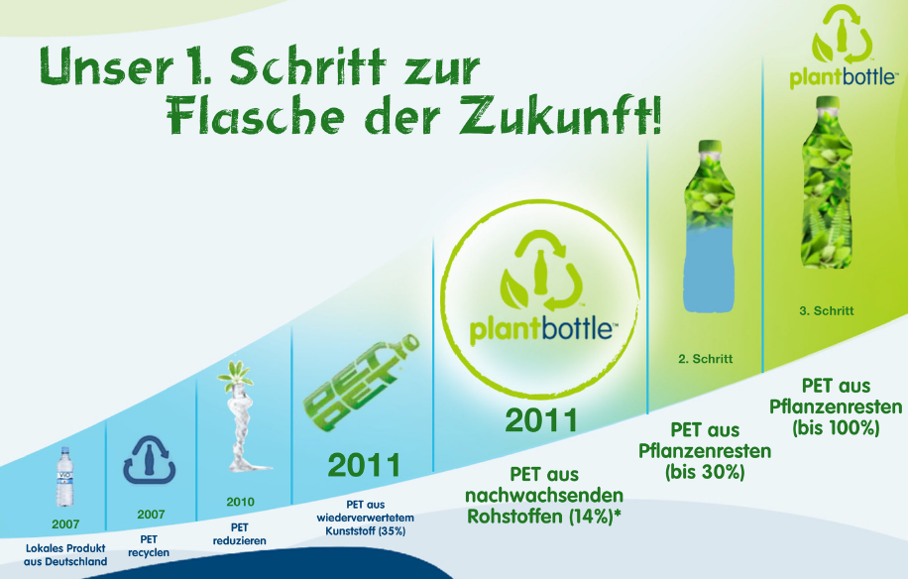
Gaining Franchise Launch Commitment
technical guidance
PlantBottle currently has a small resin upcharge due to unoptimized supply chain. Long term, PlantBottle resin will be at parity or better than traditional oil-based resin.
Be creative about offsetting the upcharge in short term. Pair with savings like:
Supply chain optimization (Dasani)
Ecoflex lightweighting (iLOHAS, Ciel)
Tax and regulatory breaks (Bonaqua)
Retailer stocking fee breaks (Vio)
As the up charge is likely to be short-term, it’s important to present PlantBottle within the broader Brand strategic framework and innovation pipeline.

Slide 21
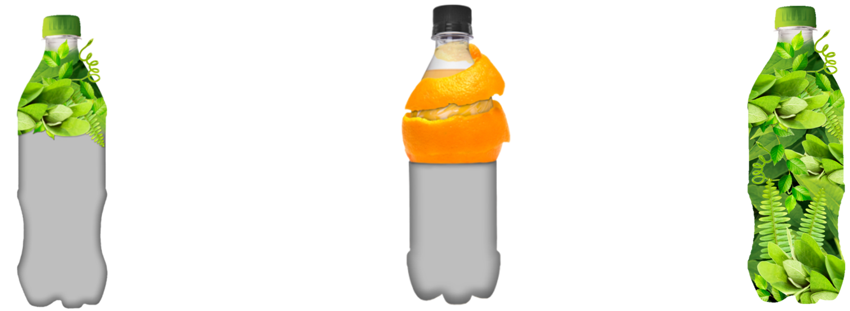
Next Generation of Resin
technical guidance
The current generation of PlantBottle is just the beginning of the pipeline. Total decoupling from oil on a commercial scale is achievable within the decade:
PlantBottle 1.0
Commercial viable today
30% plant-based
Sourced from industrial grown sugarcane
Biomass
Produced today, commercial viable in 2014
30% plant-based
Sourced from plant waste, like corn or rice husks
PlantBottle 2.0
Produced today, commercial viable by 2017
100% plant-based
Sourced from a wide variety of plant waste

Slide 22
4. PlantBottle™ Activation

Slide 23
Activation Recommendations
PlantBottle has proven to drive value, volume, brand health and authorizations when executed properly.
Key activation steps include:
Integrate PlantBottle into brand story
OWNED: Be bold on pack
EARNED: Engage key stakeholders including local NGOs and media
SHARED: Partner with customers, they see value in proposition
PAID: Devote DME and message appropriately
Educate the System

Slide 24
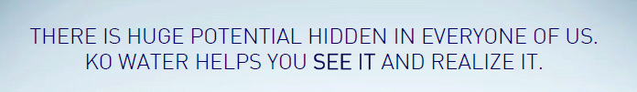

Integrate into the Brand story – e.g. Water Human Potential
PlantBottle™ activation
Critical to a successful activation is using PlantBottle to advance the overall Brand strategy.
The global Brand vision is Water Human Potential. This means that we help people recognize & realize their untapped potential.
PlantBottle can be activated in a variety of ways to help advance the Brand story. It is important to understand the category realities and Brand context and integrate the PlantBottle story accordingly.
Cultural Role
WORLD
Through PlantBottle™ KO Water is driving positive transformation in the world
KO Water enables cultural vitality - be an agent of positive transformation
Brand Role
WE
KO Water enables emotional vitality – realize my potential
PlantBottle™ helps me realize that I can make a difference
Product Role
ME
Perceptions of Plant material reinforces belief of natural or purity intrinsics
KO Water enables physical vitality - rehydrated

Slide 25
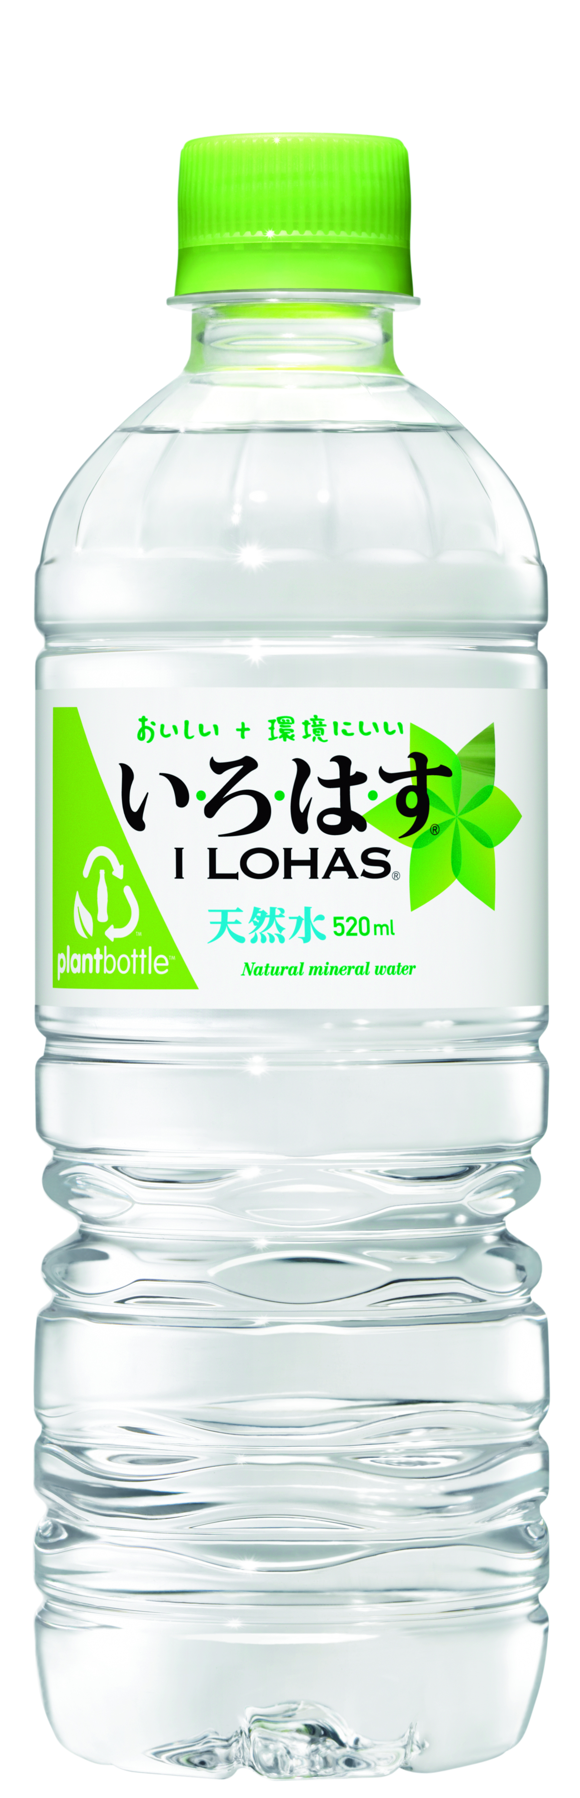

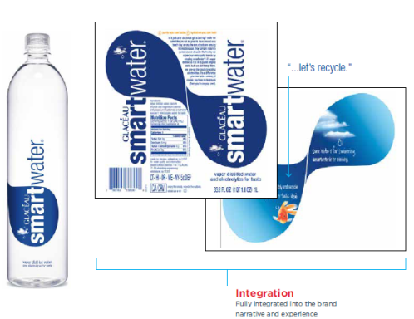
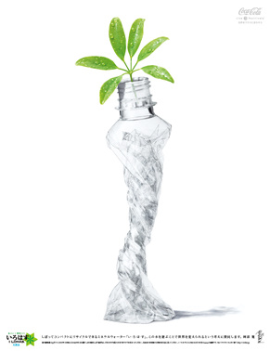
Fully integrate PlantBottle into the Brand story
PlantBottle™ activation
Even within category, different intrinsics of PlantBottle can be used to complement unique brand messages
PlantBottle as proof point of sustainability positioning
Combined with eco-flex lightweighting & sustainable sourcing
Green closure & logo
Smart packaging to reinforce ‘designed to make a difference’ positioning
Plants emphasize purity of product
Leaf prominently placed on label & secondary packaging
Green closure & logo
PlantBottle technology to reinforce innovative design of product
Golfish on interior label playfully talks about PB as innovation
No green closure nor logo nor leaf
Environment Innovation

Slide 26
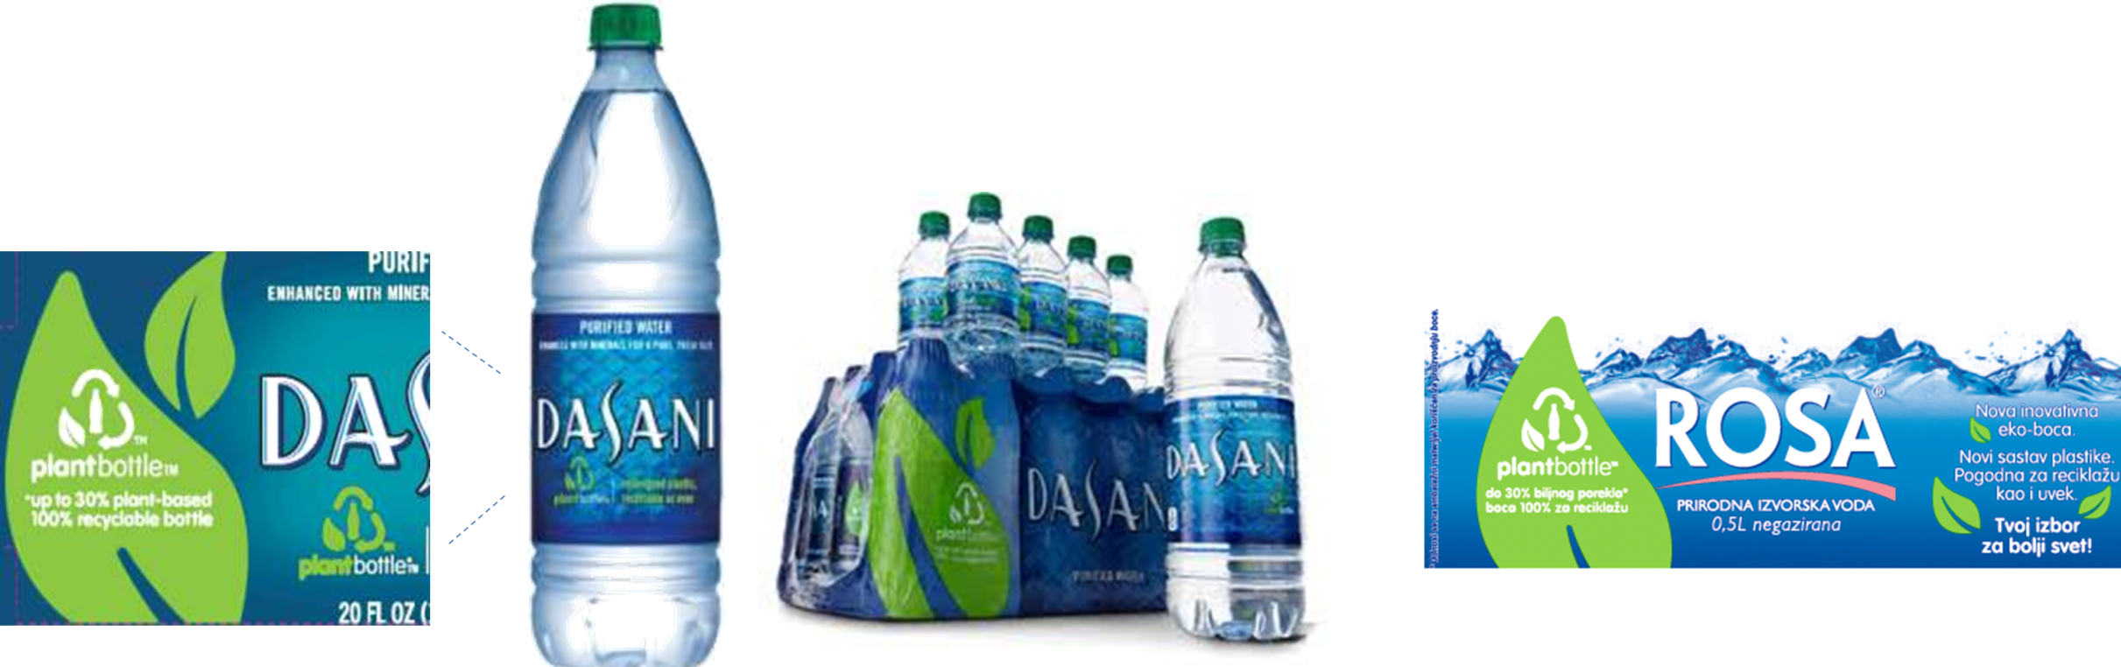
OWNED: Be bold on pack to build awareness
PlantBottle™ activation
Utilize primary and secondary packaging to boldly communicate PlantBottle and cut through in-store and on-shelf.
Leaves and green closure reflect environment, but also reinforce product values like purity and natural goodness.
Clean design approach reinforces crispness of taste and premium positioning

Slide 27
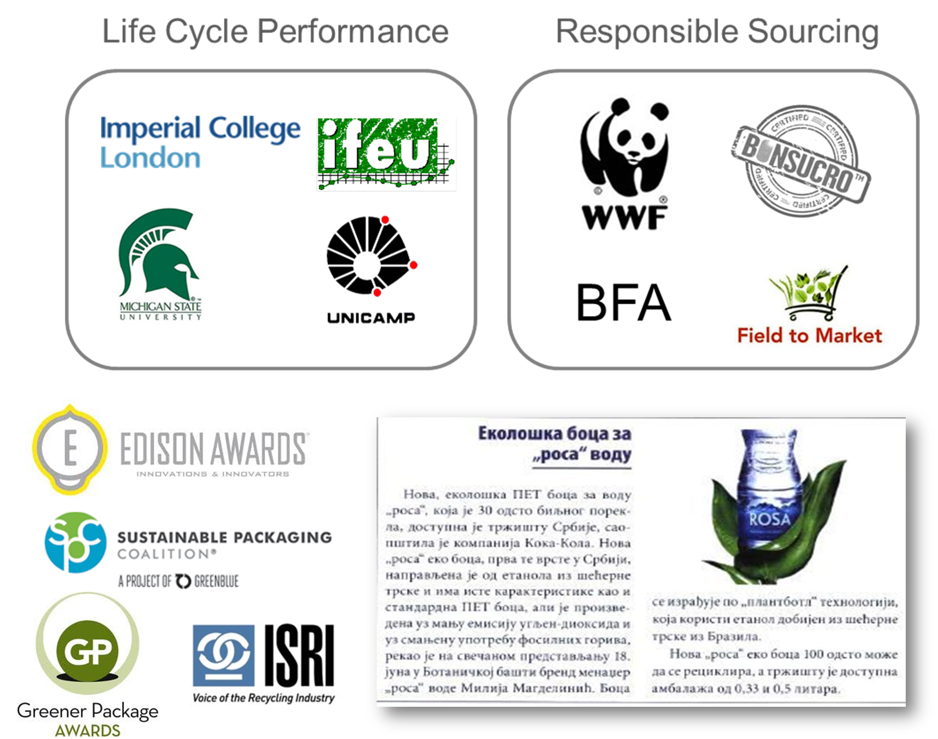
EARNED: Buzzworthy innovation
PlantBottle™ activation
Influencer outreach
PlantBottle is real innovation that draws interest from journalists, bloggers, NGOs, and other stakeholders. When done well, EARNED media can play a central part in launching PlantBottle.
Best practices to Earn media are:
Leverage global relationship with WWF
Showcase industry awards
Find local NGO partnerships (examples include….)
Partner with like-minded brands
For further PAC guidance, please refer to the Global PAC toolkit found at…

Slide 28
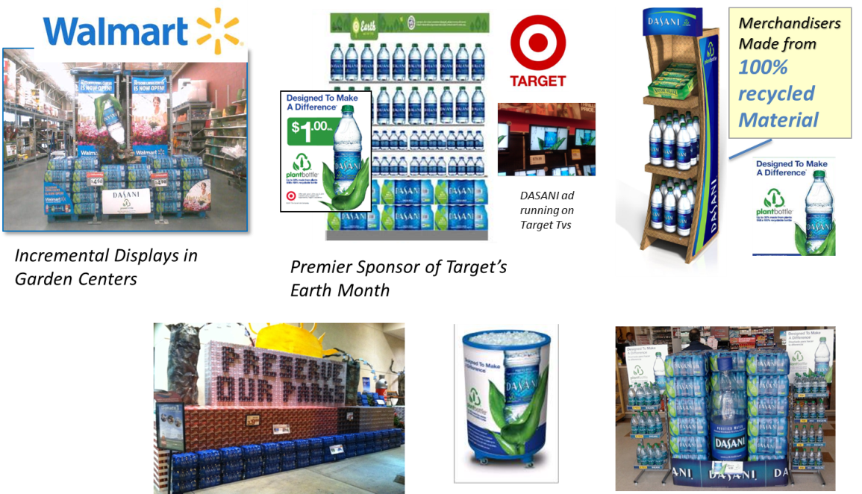
SHARED: Partner with customers on sustainability goals
PlantBottle™ activation
PlantBottle Drives Customer Value
PlantBottle can drive a greater share of in-store support. Customers see the benefit of PlantBottle long before consumers, as it meets customer’s sustainability goals (e.g. carbon offsetting). PlantBottle can be leveraged to reclaim and win new authorizations.
US Example:
Walmart relisted Dasani because of PlantBottle and now demands more brands to convert to PlantBottle, like Simply and Gold Peak
PlantBottle has cemented annual in-store promotions for brand, example: Dasani Earth Month
PlantBottle was the reason for new FSOP partnerships like Starwood, Disney & Sea World theme parks

Slide 29
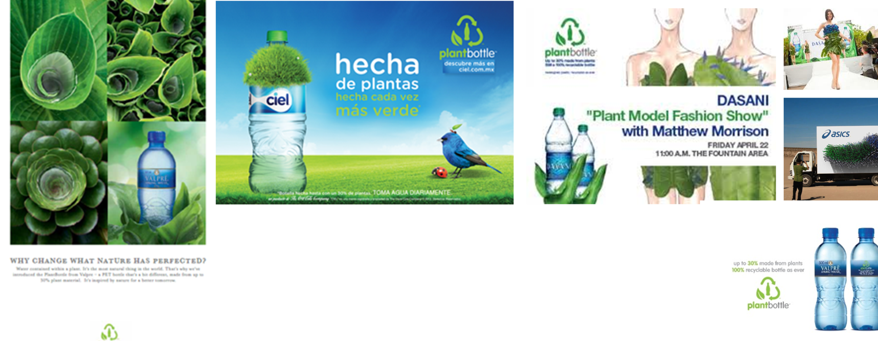
PAID: Clear & simple communications
PlantBottle™ activation
Fun and inspiring communications work for consumers. Overly technical communications or large environmental claims do not resonate.
Additional DME investment is recommended for launch – particularly given the payback
Promote 100% recyclability. This material was designed to be used over and over again. That is what makes it different than other bio-based plastics. And it helps avoid potential confusion that PlantBottle is biodegradable.

Slide 30
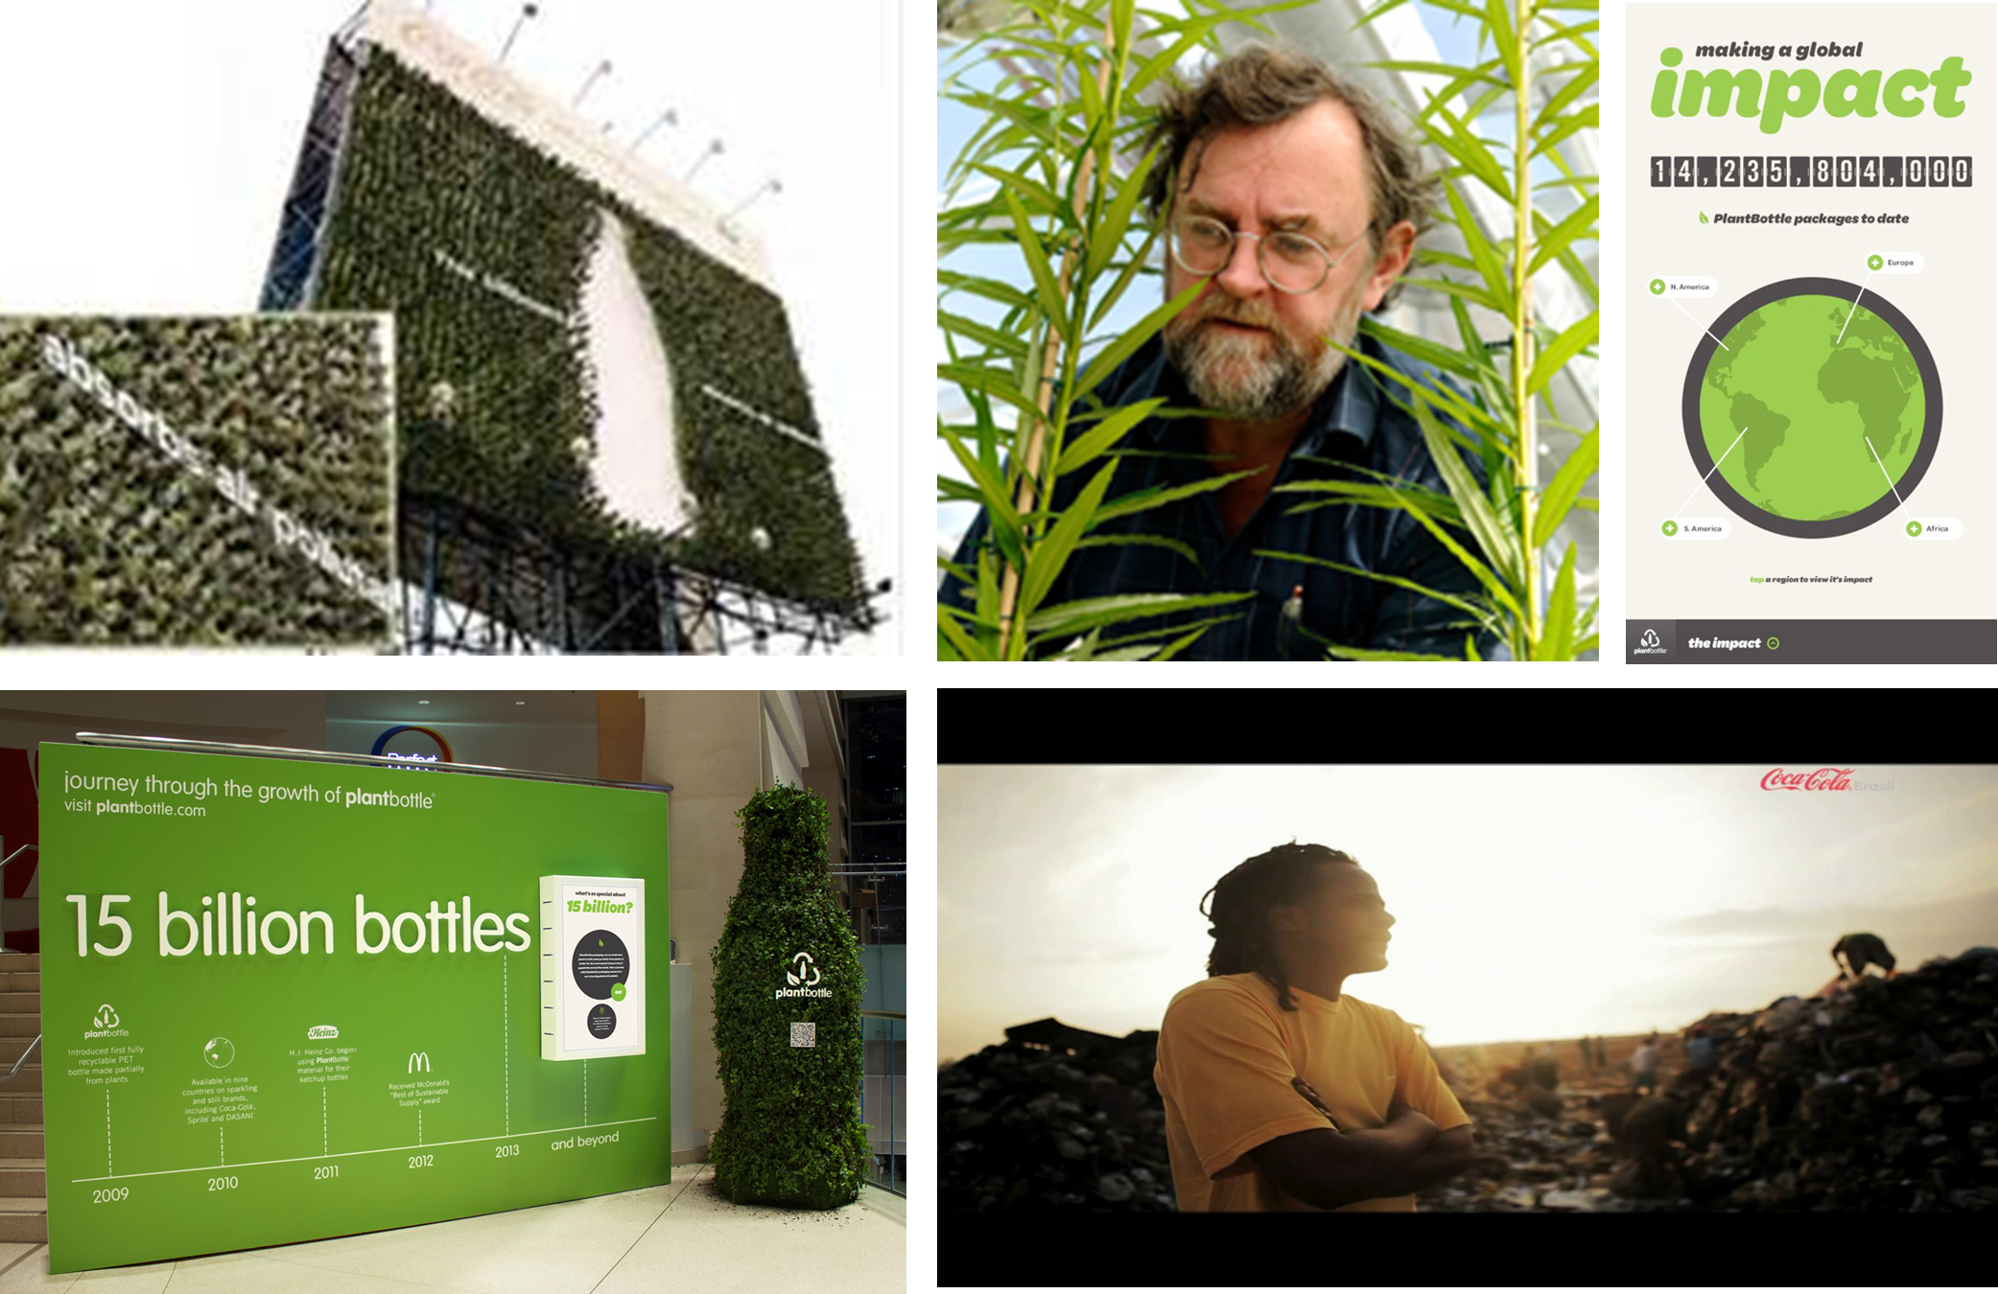
System Engagement
PlantBottle™ activation
PlantBottle™ is significant innovation for which we can all be ambassadors. Create more ambassadors within the System by educating and motivating employees through on-site promotions & MyKO outreach
Every Bottle Has a Story Videos
Packaging impact and milestone exhibits
Partnership Exhibits
Hero articles on Journey homepage

Slide 31
5. Accessing Materials, Rights & Usage

Slide 32
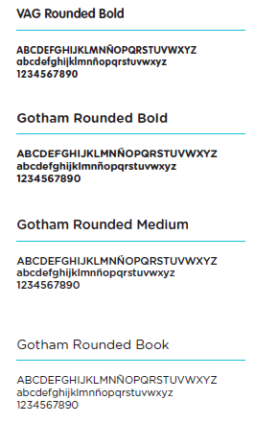
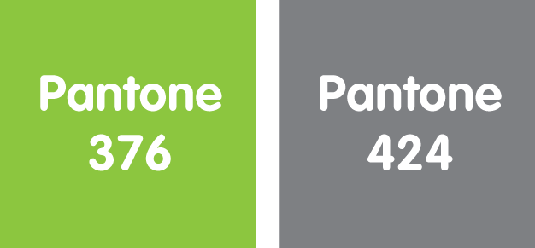
Logo Guidelines
accessing materials & usage rights
Logo lock up
Logo has 3 elements – chasing arrows, leaf and contour bottle
Name must always accompany logo – plantbottle is 1 word, 2 fonts & colors, on one line always
Qualifier must be used – ‘up to 30% made from plants, 100% recyclable plastic bottle”.
Color
Green & Grey are recommended. Exceptions allowed for brand specific colors if requested through project team.
Translations
Use ‘plantbottle’ in English. Exceptions allowed in markets that have different alphabets. Translated name must be submitted for trademark by local legal counsel.
Qualifier must always be translated into local language.
typography
PlantBottle logo is a registered trademark globally. Prior to use, all trademarks and copy must be approved by the local legal counsel for your market.

Slide 33
TVV, Print & POS Materials
accessing materials & usage rights
Global rights are currently NOT owned for any past PlantBottle™ work. For your reference, here are examples of water brand creative.
For rights information please contact The Global Rights Management team at McCann Erickson:
Janet Reagan Janet.Regan@mccann.com
Higgins Heather Heather.Higgins@mccann.com
koadland is found at www.koadland.com. New users (or old who have forgotten their passwords) can click “New User” button to request a password. Information will be emailed to you.
For help navigating or downloading files from AdLand, please reach out to our AdLand Account Manager directly:
ehiers@tagworldwide.com with a description of your request.

Slide 34
6. Contact
For further information please contact:
Andrew Rodbell
Marketing Operations, PlantBottle Project Team
arodbell@coca-cola.com
Rahul Ghosh
Global Category Director, Water & Enhanced Hydration
rahghosh@coca-cola.com

